Slide 1


Mol-Optimizer Semester B Marathon Presentation
Amit Peled, Daniel Piro, Shahar Alon & Nofar Rozenberg

Slide 2
Marathon Goals
Finish UI design.
Finish User Management & Runs Management.
Full API integration between Frontend & Backend.
Algorithms running in the system.
Algorithms Optimizations.
Start Testing MolOpt.

Slide 3
UI Design
All pages in the app are set and ready to use.
All UI-Logic has been done (Which sections, components, buttons, etc. are visible to the user).

Slide 4
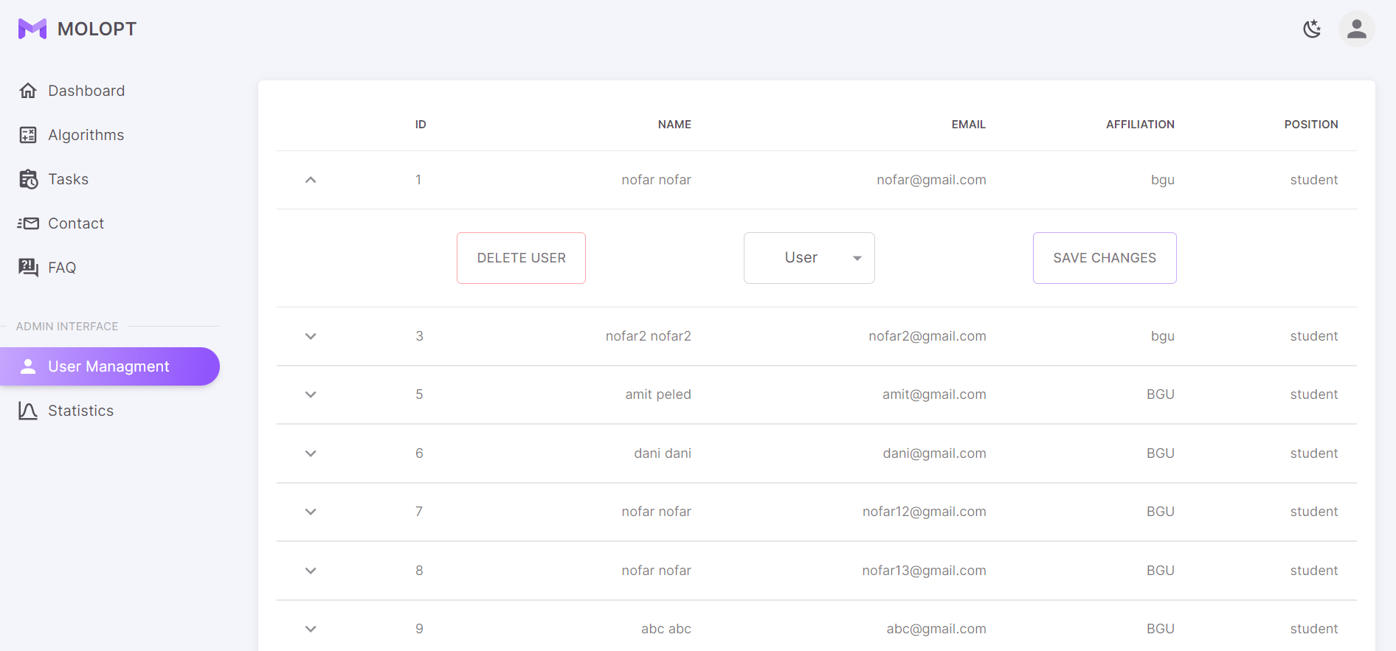
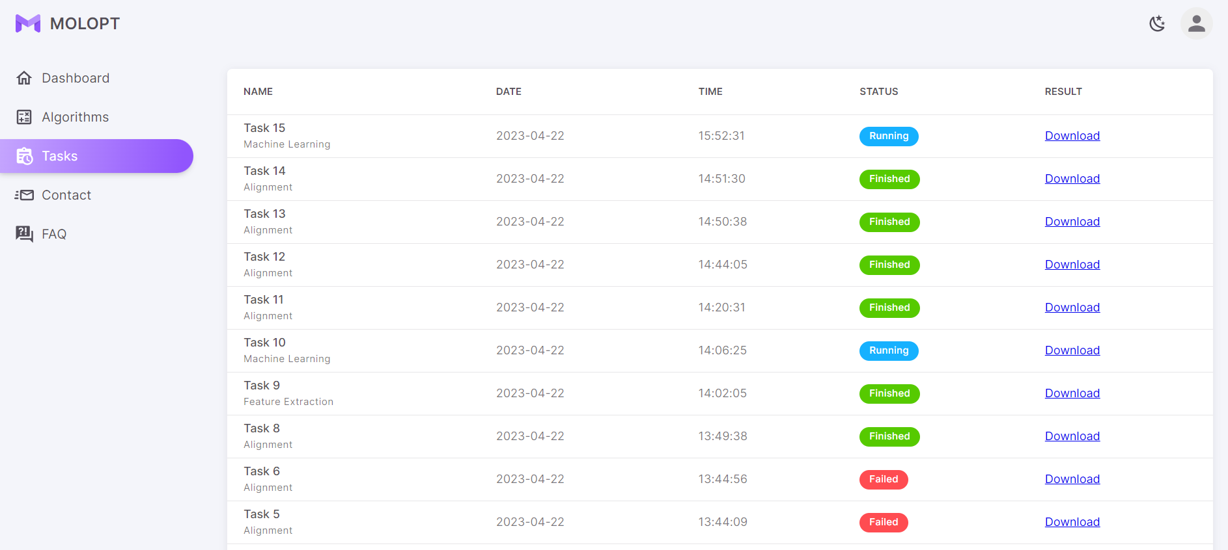
User Management & Runs Management
Photo of the users list (for admin only)
Photo of the tasks list (admin/regular user)

Slide 5
API integration between Frontend & Backend + Algorithms running in the system
(Full examples and explanations can be found in the demo-video of “iteration #2 submission”)

Slide 6
Algorithms Optimizations
Adding threading mechanism for running algorithms.
Designing algorithm runs queue.
Updating the current algorithms code (for better running time).

Slide 7
Future Tasks In MolOpt
Continue optimizing the algorithms (Queue runs, improve code logic, etc.).
Testing the full system (The only task we had left from the marathon).
Deploying to the BGU servers (still waiting for a server from our client – from our side everything is set & ready).

Slide 8
Thank You! ☺

